Slide 1
THERMAL ENGINEERING
UNIT I (B): AIR STANDARD CYCLES
LECTURE NO.3
DIESEL CYCLE
PRESENTED BY: Mr. IRSHAD M . MOMIN

Slide 2
CONSTANT PRESSURE OR DIESEL CYCLE
Introduced by Dr. R. Diesel
Unlike Otto cycle, heat is supplied at constant pressure.
1-2 Adiabatic compression.
2-3 Constant pressure heat addition.
3-4 Adiabatic expansion.
4-1 Constant volume heat rejection.
The point ‘1’ in the figure represents that cylinder is full of air with volume V1, pressure p1 and absolute temp T1.
The piston then compresses the air adiabatically (i.e. pv^gamma = const.) till the values become p2, V2 and T2 respectively (at the end of the stroke) at point 2.

Slide 3
CONSTANT PRESSURE OR DIESEL CYCLE
Heat is then added (supplied) at a constant pressure. During this heat addition let volume increases from V2 to V3 and temp T2 to T3 corresponding to point 3. this point (3) is called the point of cut-off.
The air then expands adiabatically to the conditions p4, V4 and T4 respectively corresponding to point 4.
Finally, the air rejects the heat to the cold body at constant volume till the point 1 where it returns to its original state.

Slide 4
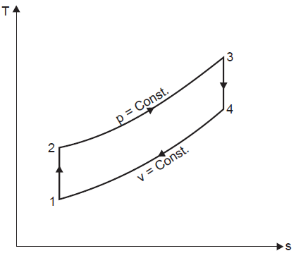
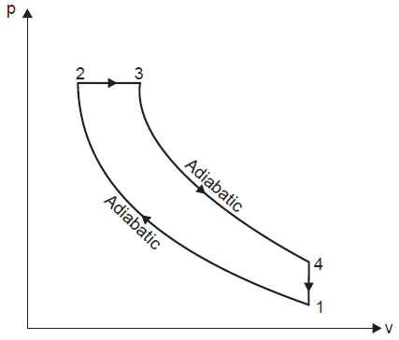
CONSTANT PRESSURE OR DIESEL CYCLE
1-2 Adiabatic compression.
2-3 Constant pressure heat addition.
3-4 Adiabatic expansion.
4-1 Constant volume heat rejection.

Slide 5
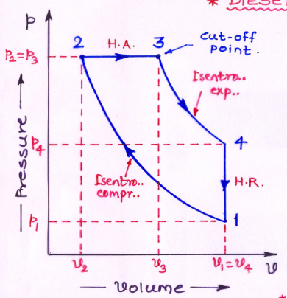
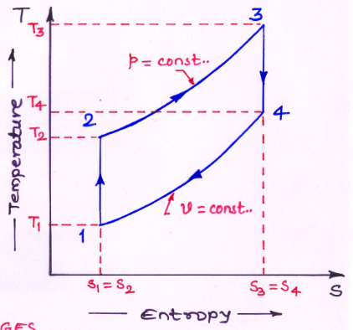
CONSTANT PRESSURE OR DIESEL CYCLE
1-2 Adiabatic compression.
2-3 Constant pressure heat addition.
3-4 Adiabatic expansion.
4-1 Constant volume heat rejection.

Slide 6
CONSTANT PRESSURE OR DIESEL CYCLE
Consider 1 kg of air (working substance)
Heat addition (supplied) at const pressure = Cp (T3 - T2)
Heat rejected at constant volume = Cv (T4 - T1)
Eff.. of Diesel cycle = (Work done) / (Heat Addition)
= (W) / (H.A.)
= (H.A. – H.R.) / (H.A.)
- - - - (1)

Slide 7
CONSTANT PRESSURE OR DIESEL CYCLE

Slide 8
CONSTANT PRESSURE OR DIESEL CYCLE

Slide 9
The compression ratio of an ideal diesel cycle is 15. The heat transfer is 1465 kJ/kg of air. Find the pressure and temperature at the end of each process and determine air standard efficiency if the inlet conditions are 300 K and 1 bar. Assume C _{v} = 0.712 kJ/kg K & R= 287 J/kg K.
GIVEN DATA –
V1 /V2 = 15
H.A. = 1465 kJ/kg
T1 = 300 K
p1 = 1 bar
R = 0.287 kJ/kg K
Cv = 0.712 kJ/kg K
Cp – Cv = R
Cp = 1 kJ/kg K
γ = 1.4

Slide 10
P2 = 44.31 bar = P3
T2 = 886.25 K
Assuming mass of air m = 1 kg
From data H.A. = 1465 kJ/kg = m Cp (T3 - T2)
T3 = 2351.25 K
Using equation p1V1 = m R T1 we find
V1 = 0.861 m^3 = V4

Slide 11
From data V1 /V2 = 15 V2 = 0.0574 m^3
For const. pressure process 2-3 V2 /T2 = V3 /T3
V3 = 0.1522 m^3
For adiabatic expansion process 3-4
T4 = 1175.87 K
p4 = 3.91 bar
H.R. = Cv (T4 - T1) =0.712(1175.87-300) = 623.61 kJ/kg
Eff = W/ H.A. = (H.A – H.R.)/ H.A.
= (1465- 623.61)/ 1465
= 0.5743 = 57.43%

Slide 12
A diesel engine working on the ideal cycle draws in air at a pressure of 110 kPa and temperature of 288 K. The air is compressed adiabatically to 3.5 MPa. Heat is taken in at constant pressure and expansion takes place adiabatically, the ratio of expansion being 5. The air is exhausted at the end of the stroke at constant volume. Calculate - i) the temperature at all key points of the cycle, ii) the heat received per kg of working fluid, iii) the heat rejected per kg of working fluid, iv) the ideal thermal efficiency.
Assume C_{P =} 1.0035 kJ/kg K & C_{V} = 0.7165 kJ/kg K.
GIVEN DATA –
p1 = 110 kPa = 110 x 10^3 N/m^2
p2 = p3 = 3.5 MPa = 3.5 x 10^6 N/m^2
T1 = 288 K
V4 /V3 = V1 /V3 = 5 since V4 = V1
Cp = 1.0035 kJ/kg K, Cv = 0.7165 kJ/kg K
Cp – Cv = R Hence R = 0.287 kJ/kg K
γ = 1.4

Slide 14
Using equation p1V1 = m R T1 we find
V1 = 0.7514 m^3 = V4
For adiabatic compression 1-2
V2 = 0.06346 m^3
For adiabatic compression 1-2
T2 = 773.97 K
For adiabatic expansion 3-4
p4 = 367.71x10^3 N/m^2

Slide 15
V3 = 0.1502 m^3
For const. pressure process 2-3 T2 /V2 = T3 /V3
T3 = 1833 K
For adiabatic expansion process 3-4
T4 = 962.62 K
For const. pressure process 2-3, H.A. = m Cp (T3 - T2)
H.A. = 1 x 1.0035 x (1833 - 774)
H.A. = 1062.7 kJ/kg

Slide 16
For const. volume process 4-1, H.R. = m Cv (T4 - T1)
H.R. = 1 x 0.7165 x (962.62-288)
H.R. = 483.36 kJ/kg
Efficiency = W/ H.A. = (H.A – H.R.)/ H.A.
= (1062.7- 483.36)/ 1062.7
= 0.5451 = 54.51%

