Slide 1
THERMAL ENGINEERING
UNIT I (B): AIR STANDARD CYCLES
LECTURE NO.2
OTTO CYCLE
PRESENTED BY: Mr. IRSHAD M . MOMIN

Slide 2
CONSTANT VOLUME OR OTTO CYCLE
Conceived by ‘Otto’
On this cycle petrol, gas and many types of oil engines work. Standard of comparison for internal combustion engines.
Adiabatic compression.
Constant volume heat addition.
Adiabatic expansion.
Constant volume heat rejection.
The point ‘1’ in the figure represents that cylinder is full of air with volume V1, pressure p1 and absolute temp T1.
The P-V and T-S diagram of this cycle is shown in figure

Slide 3
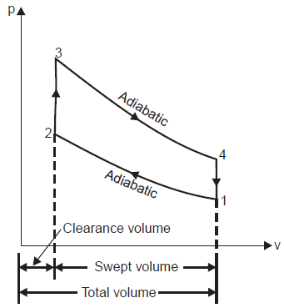
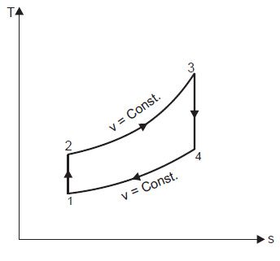
THE OTTO CYCLE

Slide 4
THE OTTO CYCLE
Line 1-2 represents the adiabatic compression of air due to which p1, V1 and T1 change to p2, V2 and T2 respectively.
Line 2-3 shows the supply of heat to the air at constant volume so that p2 and T2 change to p3 and T3 (since V2 = V3).
Line 3-4 represents the adiabatic expansion of the air. During expansion p3, V3 and T3 change to a final value of p4, V4 or V1 and T4 respectively.
Line 4-1 shows the rejection of heat by air at constant volume till original state (point 1) reaches.

Slide 5
THE OTTO CYCLE
Consider 1 kg of air (working substance)
Heat addition (supplied) at const volume = Cv (T3 - T2)
Heat rejected at constant volume = Cv (T4 - T1)
Eff.. of Otto cycle = (Work done) / (Heat Addition)
= (W) / (H.A.)
= (H.A. – H.R.) / (H.A.)
- - - - (1)

Slide 6
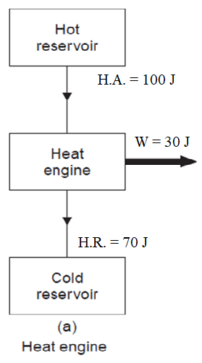
EFFICIENCY OF HEAT ENGINE
Heat Addition (H.A.) = 100 J
Heat Rejection (H.R.) = 70 J
Work done (W) = 30 J
Efficiency of engine =
(output) / (input)
= (W) / (H.A.)
= (H.A. – H.R.) / (H.A.)
= (100 – 70) / (100)
= 30%

Slide 7
THE OTTO CYCLE

Slide 9
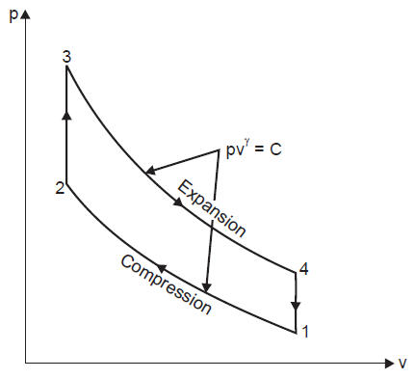
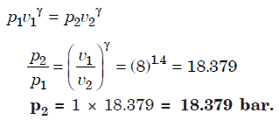

Slide 11
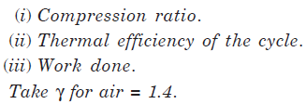
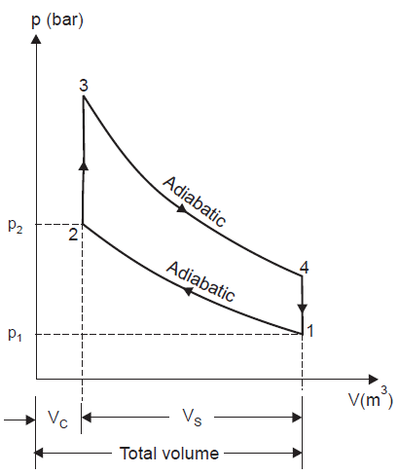
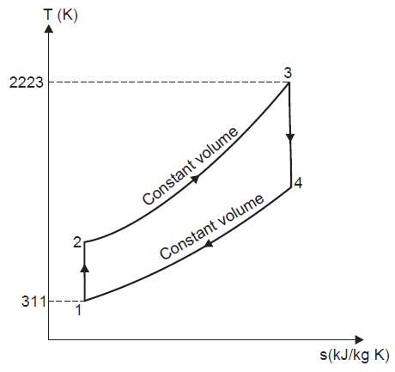

Slide 12
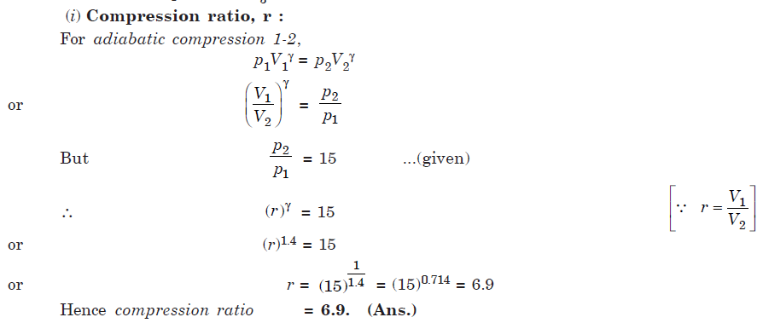

Slide 14
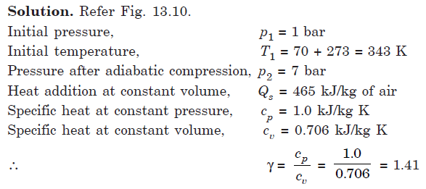

Slide 15
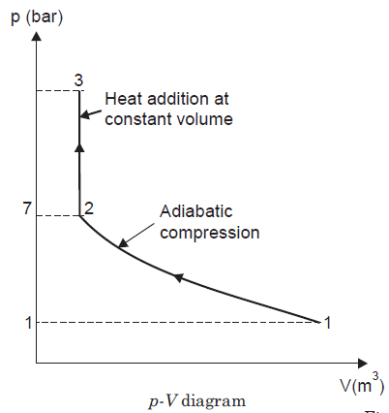
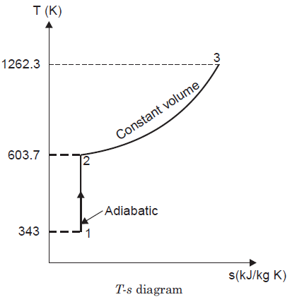
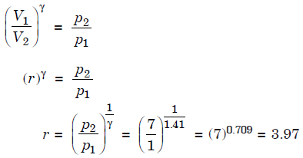

Slide 16
