Slide 1
THERMAL ENGINEERING
UNIT I (B): AIR STANDARD CYCLES
LECTURE NO.1
INTRODUCTION TO AIR STANDARD CYCLES & CARNOT CYCLE
PRESENTED BY: Mr. IRSHAD M . MOMIN

Slide 2
CYCLE
It is defined as a repeated series of operations occuring in a certain order. It may be repeated by repeating the processes in the same order.
The cycle which is of imaginary perfect engine is called ideal cycle. In ideal cycle all accidental heat losses are prevented and the working substance is assumed to behave like a perfect working substance.
The cycle which is of actual engine is called actual cycle.

Slide 3
AIR STANDARD EFFICIENCY
To compare the effect of different cycles, it is of paramount importance that the effect of the calorific value of the fuel is altogether eliminated.
This can be achieved by considering air (assumed to behave as a perfect gas) as the working substance in the engine cylinder.
The efficiency of engine using air as the working medium is known as “Air standard efficiency” and is often called as “Ideal efficiency”.
The actual efficiency of a cycle is always less than the air standard efficiency of that cycle under ideal conditions. This is taken into account by introducing a new term “Relative efficiency”.

Slide 4

AIR STANDARD EFFICIENCY
Relative efficiency is defined as,
The analysis of all air standard cycles is based upon the following assumptions:
Assumptions:
The gas in the engine cylinder is a perfect gas i.e. it obeys the gas laws and has constant specific heats.
The physical constants of the gas in the cylinder are the same as those of air at moderate temp i.e. the molecular weight of cylinder gas is 29.
Cp = 1.005 kJ/kg K, Cv = 0.718 kJ/kg K

Slide 5
AIR STANDARD EFFICIENCY
Assumptions:
The compression and expansion processes are adiabatic and they take place without internal friction, i.e. these processes are isentropic.
No chemical reaction takes place in the cylinder. Heat is supplied or rejected by bringing a hot body or a cold body in contact with cylinder at appropriate points during the process.
The cycle is considered closed with the same ‘air’ always remaining in the cylinder to repeat the cycle.

Slide 6
THE CARNOT CYCLE
This cycle has the highest possible efficiency & consists of four simple operations namely,
Isothermal expansion.
Adiabatic expansion.
Isothermal compression.
Adiabatic compression.
The Carnot cycle occurs in the following way –
One kg of air is enclosed in the cylinder made of perfect non-conducting material except at the end.
A source of heat ‘H’ is supposed to provide unlimited quantity of heat, non-conducting cover ‘C’ and a sump ‘S’ (infinite capacity) so that its temp remains unchanged irrespective of the fact how much heat is supplied to it.

Slide 7
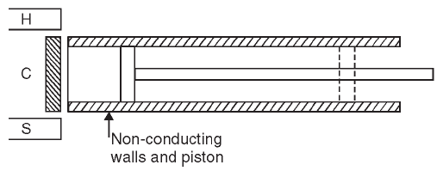
THE CARNOT CYCLE
The temp of source ‘H’ is T1 and the same is of the working substance. The working substance while rejecting heat to sump ‘S’ has the temp T2 i.e the same as that of sump ‘S’.
The four stages of Carnot cycle are represented on P-V and T-S diagram.

Slide 8
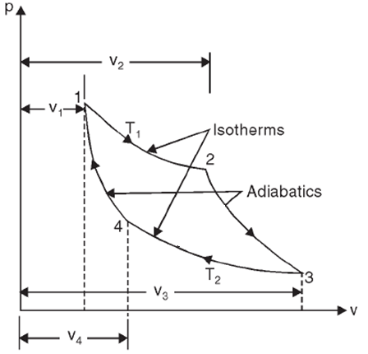
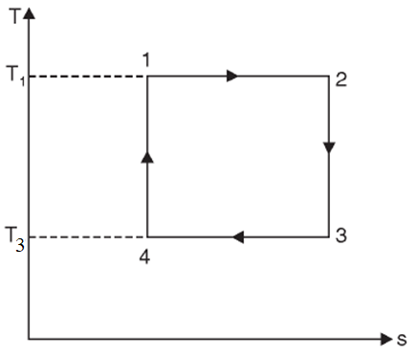
THE CARNOT CYCLE
(1-2) Isothermal expansion, (2-3) Adiabatic expansion,
(3-4) Isothermal compression, (4-1)Adiabatic compression.

Slide 9
THE CARNOT CYCLE
Stage 1 - Isothermal expansion (1-2)
It takes place at temp T1 when source of heat H is applied to the end of cylinder. Heat addition (supplied) to the working substance is given by,
H.A. = R T1 loge r - - - - - - - (1)
where r = v2 / v1 = expansion ratio
Stage 2 – Adiabatic expansion (2-3)
It represents the application of non-conducting cover to the end of cylinder. This is followed by the adiabatic expansion and the temp falls from T2 to T3.

Slide 10
THE CARNOT CYCLE
Stage 3 - Isothermal compression (3-4)
It takes place when sump ‘S’ is applied to the end of cylinder. Heat is rejected during this operation by the working substance is given by,
H.R. = R T3 loge r - - - - - - - (2)
where r = v3 / v4 = compression ratio
Stage 4 – Adiabatic compression (4-1)
It represents repeated application of non-conducting cover and adiabatic compression due to which temp increases from T4 to T1.
Ratio of expansion during isotherm 1-2 and ratio of compression during isotherm 3-4 must be equal to get a closed cycle.

Slide 11
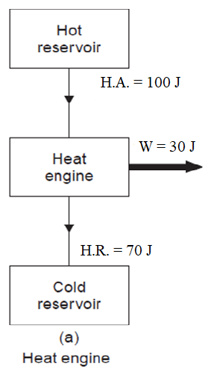
EFFICIENCY OF HEAT ENGINE
Heat Addition (H.A.) = 100 J
Heat Rejection (H.R.) = 70 J
Work done (W) = 30 J
Efficiency of engine =
(output) / (input)
= (W) / (H.A.)
= (H.A. – H.R.) / (H.A.)
= (100 – 70) / (100)
= 30%

Slide 12
THE CARNOT CYCLE
Efficiency of Carnot cycle
Efficiency of Carnot cycle = (output) / (input)
= (Work done) / (Heat Addition)
= (W) / (H.A.)
= (H.A. – H.R.) / (H.A.)
Substituting equation (1) and (2) in above we get,
Efficiency = (R T1 loge r – R T3 loge r) / (R T1 loge r )
= (T1 – T3) / (T1)
= (Tmax – Tmin) / (Tmax)
From this equation – if temp T3 decreases eff. increases and it becomes 100% if T3 becomes absolute zero, which is impossible to attain.

Slide 13
THE CARNOT CYCLE
It is not possible to produce an engine working on Carnot cycle as it necessitates the piston to travel very slowly during first portion of the forward stroke (isothermal expansion) and to travel more quickly during the remainder of the stroke (adiabatic expansion) which however is not practicable.

Slide 14
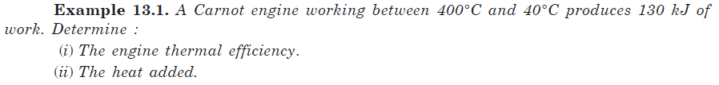


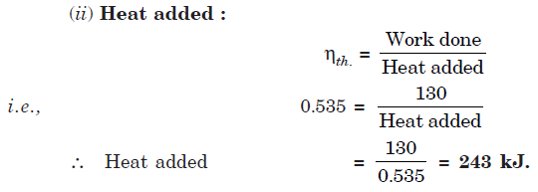

Slide 15
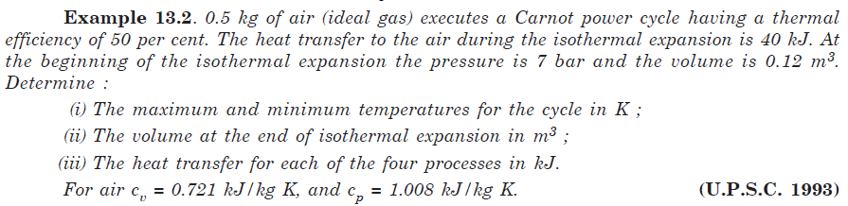
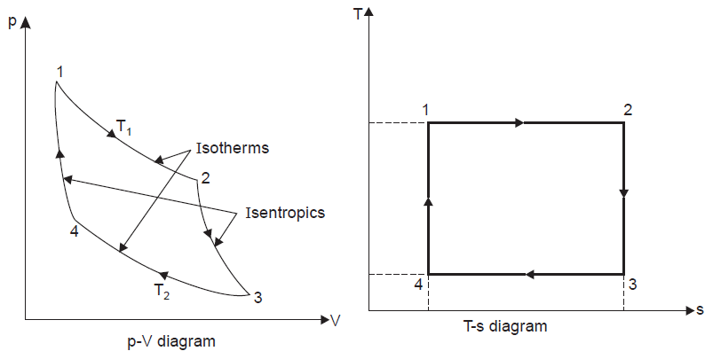

Slide 16
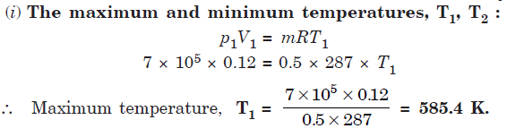


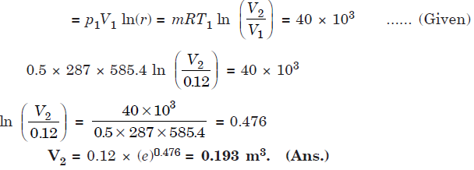

Slide 17
